Slide 1

UNIVERSITY INSTITUTE OF ENGINEERING
COMPUTER SCIENCE ENGINEERING
Bachelor of Engineering (Computer Science & Engineering)
Subject Name: Big Data Analytics
Subject Code: 20CST-471
Characteristics of Big data
Mapped with CO1
Prepared By:
Er. Ankita Sharma
DISCOVER . LEARN . EMPOWER

Slide 2
Characteristics of Big data
The characteristics of Big Data, often referred to as the "3Vs"—Volume, Velocity, and Variety—highlight the unique attributes that distinguish it from traditional data.
Firstly, Volume signifies the sheer magnitude of data generated, collected, and stored by organizations. Big Data involves datasets that are so large and complex that they surpass the processing capacity of conventional databases, necessitating innovative storage and analysis solutions.

Slide 3
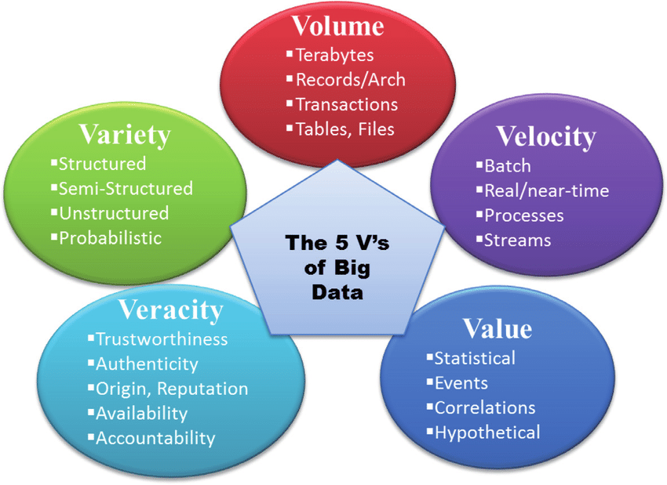

Slide 4
Secondly, Velocity underscores the speed at which data is generated, processed, and analyzed. With the advent of real-time data sources such as social media, sensors, and IoT devices, the ability to handle and derive insights from data in near-real-time has become a critical aspect of Big Data analytics.
This rapid pace of data creation requires advanced processing capabilities to keep up with the dynamic nature of information flow.

Slide 5
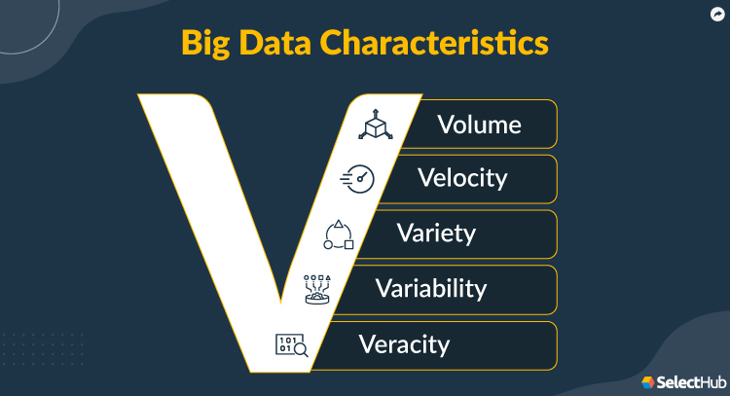
Thirdly, Variety reflects the diverse types and formats of data within the Big Data landscape. This includes structured data (e.g., databases and spreadsheets) as well as unstructured data (e.g., text, images, videos).
Big Data analytics must be flexible enough to handle this diversity, employing techniques like data integration and processing to derive meaningful insights from disparate sources.

Slide 6
Beyond the 3Vs, two additional characteristics—Veracity and Value—have been recognized.
Veracity concerns the quality and reliability of the data. Given the diverse sources and formats of Big Data, ensuring accuracy and addressing issues such as data inconsistencies and incompleteness becomes a significant challenge.
Finally, Value emphasizes the overarching objective of extracting meaningful insights and value from Big Data analytics. The ultimate goal is to turn raw data into actionable information that can drive informed decision-making, enhance processes, and contribute to organizational success.

Slide 7
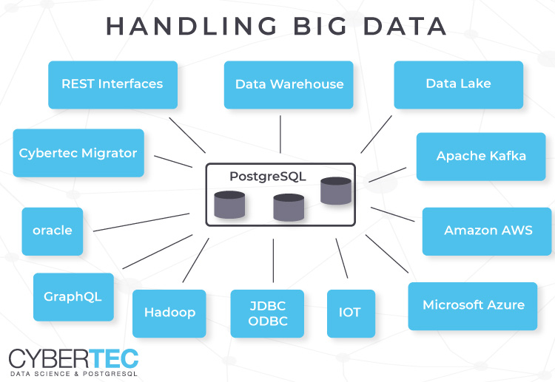

Slide 8
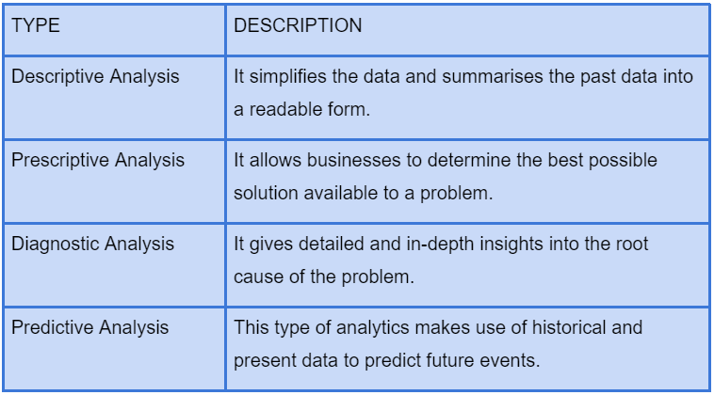

Slide 9
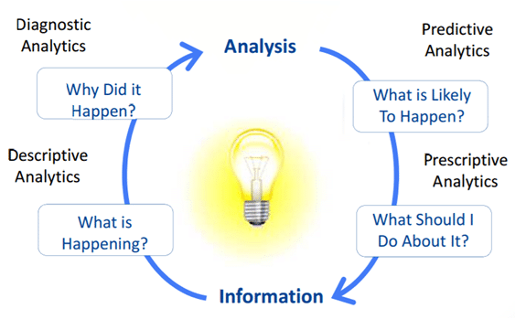

Slide 10
Thankyou

